Slide 1

APEX INSTITUTE OF TECHNOLOGY
DEPARTMENT OF COMPUTER SCIENCE & ENGINEERING
Statistics for Data Science(23CSH-233)
Faculty: Prof. (Dr.) Madan Lal Saini(E13485)
Inferential Statistics
DISCOVER . LEARN . EMPOWER

Slide 2
Statistics for Data Science : Course Objectives
COURSE OBJECTIVES
The Course aims to:
To equip students with the skills to summarize and interpret data using descriptive statistics and visualization techniques.
To develop a foundational understanding of probability and its applications in data science.
To enable students to perform hypothesis testing and construct confidence intervals for statistical inference.
To teach students how to build and assess linear and logistic regression models for predictive analysis.
To provide hands-on experience with statistical software for data manipulation, analysis, and visualization.

Slide 3
COURSE OUTCOMES
On completion of this course, the students shall be able to:-
CO1 | Summarize and describe the main features of a dataset using measures such as mean, median, mode, variance, and standard deviation, as well as graphical representations like histograms, box plots, and scatter plots.
CO2 | Understand of probability theory, including concepts such as random variables, probability distributions, and the law of large numbers, enabling them to model and reason about uncertainty in data.
CO3 | Apply/perform statistical inference, including hypothesis testing, confidence interval estimation, and p-value computation, to draw valid conclusions from sample data about larger populations.
CO4 | Apply linear and logistic regression techniques to identify relationships between variables, make predictions, and evaluate model performance.
CO5 | Utilize statistical software tools to perform data analysis, including data cleaning, transformation, visualization, and implementing various statistical methods.

Slide 4
Unit-3 Syllabus
Unit-3 | Inferential Statistics
Inferential Statistics & Hypothesis Testing | Statistical Inference Terminology, Hypothesis Testing, Parametric Tests, Non-parametric Tests
Industry Application | Hypothesis Testing using Excel Industry Practices & Applications of Statistics

Slide 5
SUGGESTIVE READINGS
TEXT BOOKS:
T1. Hastie, Trevor, et al., The elements of statistical learning. Vol. 2. No. 1. New York: Publisher: Springer, Edition: Second Edition (2009), ISBN: 978-0387848570
T2. Montgomery, Douglas C., and George C. Runger. Applied statistics and probability for engineers. John Wiley & Sons, 2010.
T3. Probability and Statistics The Science of Uncertainty Second Ed., Michael J. Evans and Jeffrey S. Rosenthal.
REFERENCE BOOKS:
R1. Practical Statistics for Data Scientists: 50 Essential Concepts, Authors: Peter Bruce, et al, Publisher: O'Reilly Media, Edition: Second Edition (2020), ISBN: 978-1492072942
R2. An Introduction to Statistical Learning: with Applications in R, Authors: Gareth James, et al, Publisher: Springer, Edition: Second Edition (2021), ISBN: 978-1071614174
R3. Think Stats: Exploratory Data Analysis in Python, Author: Allen B. Downey, Publisher: O'Reilly Media, Publication Year: 2014 (2nd Edition), ISBN: 978-1491907337

Slide 6

Statistics in Our Life
Finance
Crimes and legal system
Medical
Quality
Etc.
https://www.youtube.com/watch?v=jbkSRLYSojo

Slide 7
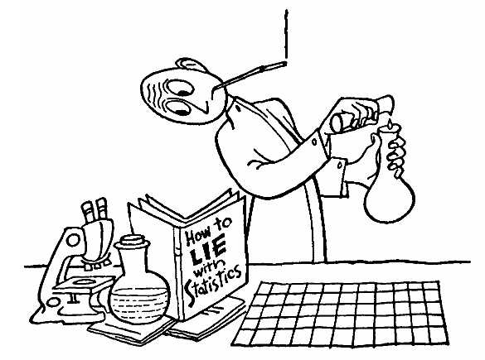
Statistical Lies
http://www.physics.csbsju.edu/stats/display.html

Slide 8
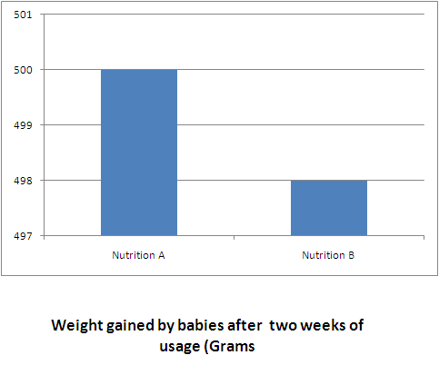
Statistical Lies

Slide 9
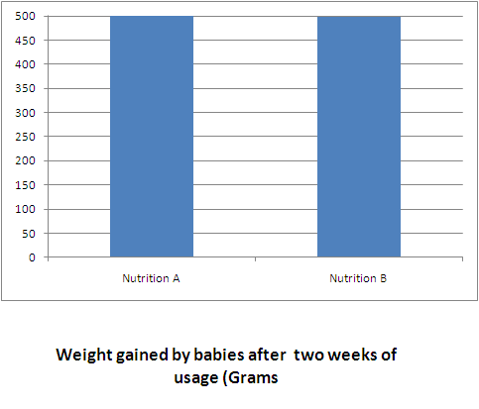
Statistical Lies

Slide 10
Definitions
Following slides are copied from different resources

Slide 11
Variables
A variable is a characteristic or condition that can change or take on different values.
Most research begins with a general question about the relationship between two variables for a specific group of individuals.

Slide 12
Experiments
The goal of an experiment is to demonstrate a cause-and-effect relationship between two variables; that is, to show that changing the value of one variable causes changes to occur in a second variable.

Slide 13
Types of Variables
Variables can be classified as discrete or continuous.
Discrete variables (such as class size) consist of indivisible categories, and continuous variables (such as time or weight) are infinitely divisible into whatever units a researcher may choose. For example, time can be measured to the nearest minute, second, half-second, etc.

Slide 14
Population
The entire group of individuals is called the population.
For example, a researcher may be interested in the relation between class size (variable 1) and academic performance (variable 2) for the population of third-grade children.

Slide 15
Sample
Usually populations are so large that a researcher cannot examine the entire group. Therefore, a sample is selected to represent the population in a research study. The goal is to use the results obtained from the sample to help answer questions about the population.

Slide 16
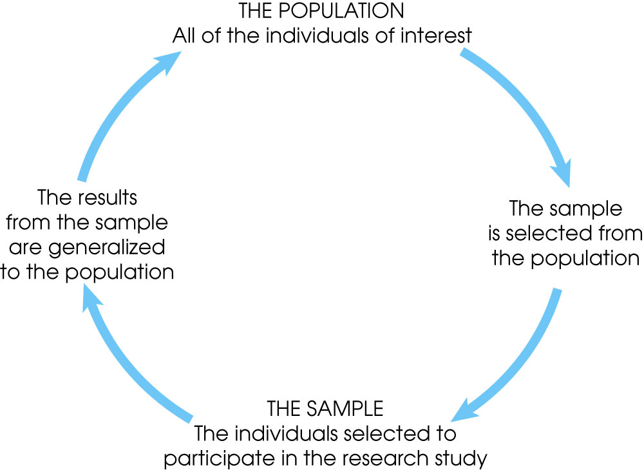
Notes:
Figure 1.1
The relationship between a population and a sample.

Slide 17
Simple random sample
A simple random sample (SRS) of size n is a sample chosen by a method in which each collection of n population items is equally likely to comprise the sample, just as in the lottery.

Slide 18
Independent Items
The items in a sample are independent if knowing the values of some of the items does not help to predict the values of the others.
Items in a simple random sample may be treated as independent in most cases encountered in practice. The exception occurs when the population is finite and the sample comprises a substantial fraction (more than 5%) of the population.

Slide 19
Descriptive Statistics
Descriptive statistics are methods for organizing and summarizing data.
For example, tables or graphs are used to organize data, and descriptive values such as the average score are used to summarize data.
A descriptive value for a population is called a parameter and a descriptive value for a sample is called a statistic.

Slide 20
Inferential Statistics
Inferential statistics are methods for using sample data to make general conclusions (inferences) about populations.
Because a sample is typically only a part of the whole population, sample data provide only limited information about the population. As a result, sample statistics are generally imperfect representatives of the corresponding population parameters.

Slide 21
Sampling Error
The discrepancy between a sample statistic and its population parameter is called sampling error.
Defining and measuring sampling error is a large part of inferential statistics.

Slide 22
Types of Data
Numerical or quantitative if a numerical quantity is assigned to each item in the sample.
Continuous:
Height
Weight
Age
Discrete
Number of students in class
Number of equipment in a project

Slide 23
Types of Data
Categorical or qualitative if the sample items are placed into categories (always discrete)
Nominal (if there is no natural order between the categories)
Gender
Hair color
Zip code
Ordinal (if an ordering exists)
Customer satisfaction surveys.
Students grades.

Slide 24
Summary Statistics
Sample Mean:
Sample Variance:
Sample standard deviation is the square root of the sample variance.

Slide 25
Definition of a Median
The median is another measure of center, like the mean. To find it:
If n is odd, the sample median is the number in
position
If n is even, the sample median is the average
of the numbers in positions

Slide 26
Summary
Importance of statistics.
Population versus sample.
Mean, median and standard deviation.

Slide 27
References
Books:
Hastie, Trevor, et al., The elements of statistical learning. Vol. 2. No. 1. New York: Publisher: Springer, Edition: Second Edition (2009), ISBN: 978-0387848570
Practical Statistics for Data Scientists: 50 Essential Concepts, Authors: Peter Bruce, et al, Publisher: O'Reilly Media, Edition: Second Edition (2020), ISBN: 978-1492072942
Research Papers:
Garg, Ram and Goyal, Ruchi, Inferential Statistics As a Measure of Judging the Short-Term Solvency An Empirical Study of Three Steel Companies in India (February 5, 2019). International Journal of Advanced Studies of Scientific Research, Vol. 4, No. 1, 2019, Available at SSRN: https://ssrn.com/abstract=3329388.
Alacaci, C. (2004). Inferential Statistics: Understanding Expert Knowledge and its Implications for Statistics Education. Journal of Statistics Education, 12(2). https://doi.org/10.1080/10691898.2004.11910737
Websites:
https://www.simplilearn.com/inferential-statistics-article/
https://builtin.com/data-science/inferential-statistics#:~:text=Inferential%20statistics%20is%20the%20practice,sample%20data%20sample%20or%20population./
Videos:
https://www.youtube.com/watch?v=cjTgyRUaD1s&list=PLbRMhDVUMngeD_vOeveVE-3b7wu_AZph9
https://www.youtube.com/watch?v=ZmCBF5JXOPM&list=PLFW6lRTa1g80s2MWqXNg2o0haq1k14v2I

Slide 28
THANK YOU
For queries
Email: madan.e13485@cumail.in

